Slide 1



CMR TECHNICAL CAMPUS
UGC AUTONOMOUS
Accredited by NBA & NAAC with ‘A’ Grade
Approved by AICTE,New Delhi and affiliated to JNTU,Hyderabad Kandlakoya (V), Medchal Road, Hyderabad -501401, Telangana
Department of Computer Science and Engineering
Mini Project Final Review
E-LIBRARY WITH URLS TUTORIAL , PDF BOOKS & VIDEOS
BATCH NO-23
UNDER THE GUIDENCE OF : PRESENTED BY :
RAKSHITHA OKALI Anugna Lingampalli
(Assistant Professor) 207R1A0590

Slide 2

Abstract
Existing System
Disadvantages of Existing System
Proposed System
Advantages of Proposed System
Hardware and software requirements
Novelty of project
Architecture
Modules
UML Diagrams

Slide 3
Sample Code
Results
Conclusion
Future Scope
References
Github Link

Slide 4

ABSTRACT
Digital libraries are considered as the most complex form of data systems that associate with the digital document preservation, distributed database management, hypertext, filtering, information retrieval, and selective dissemination of information.
This project provides information to the audience on the subject matter in terms of what has been already discovered and explored on the importance of Digital Library and what all can be further explored.
The idea is to brief the readers about the concept of library resources shifted into digital libraries with the help of technology and its growth sourced from already existing literature.

Slide 5
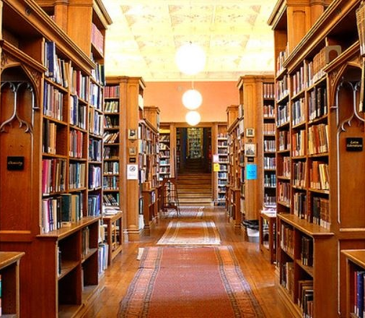
Existing system
Concept of digital libraries has existed from the 20th Century.
They are not only the digital corresponding entity of traditional (physical) libraries but they have become involved in networking systems.

Slide 6
Disadvantages of Existing system
Physical Boundary
Available for Specific Time period
Worries about Misplaced or Stolen
Lack of Books
High Cost to buy books
Penalty for late return

Slide 7

Proposed System
The designing of innovative models and architectures are transforming this combination of information along with user requirements for giving improved well-versed decisions and enriching the customer experience.
It facilitates a reliable platform for exchanging services and transactions through a disseminated network.

Slide 8
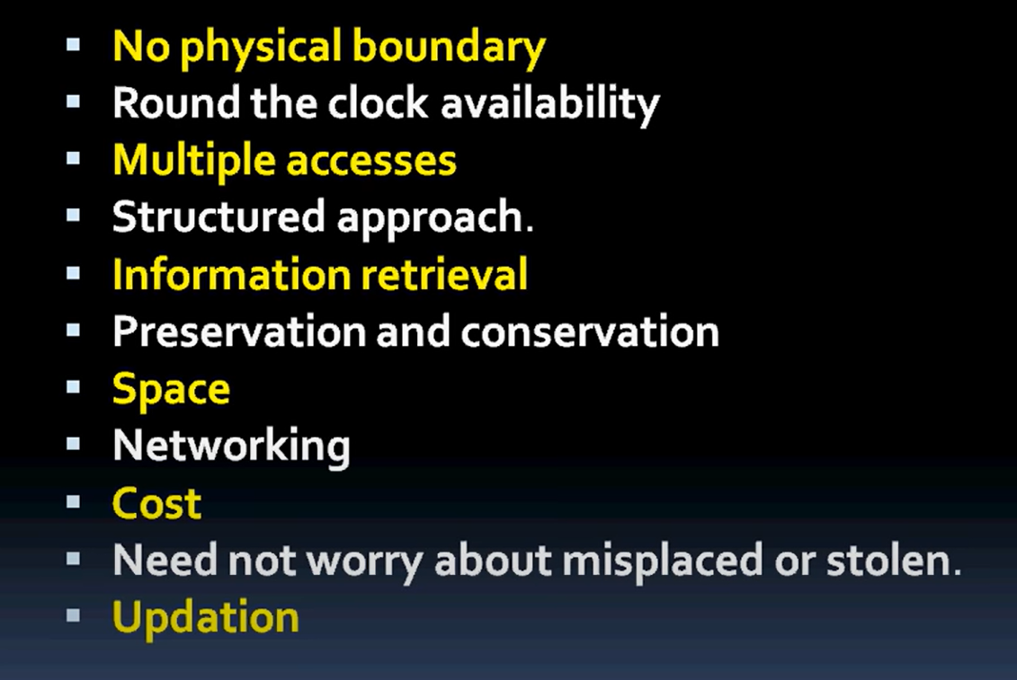
Advantages of Proposed System

Slide 9
HARDWARE & SOFTWARE REQUIREMENTS
HARDWARE REQUIRMENTS :
System : i3 or above.
Ram : 4 GB.
Hard Disk : 40 GB
SOFTWARE REQUIRMENTS :
• Operating system : Windows8 or Above
Coding Language : python

Slide 10
Novelty of the Project
There is a future scope of this facility that many more features such as online lectures video tutorials can be added into it
Easy to download and utilize
User friendly and can be accessed easily
Can add multiple Books, Videos, Pdfs, Urls and Tutorials for a single subject
We can add , delete or update the Books , Videos , Pdfs , Urls and Tutorials

Slide 11
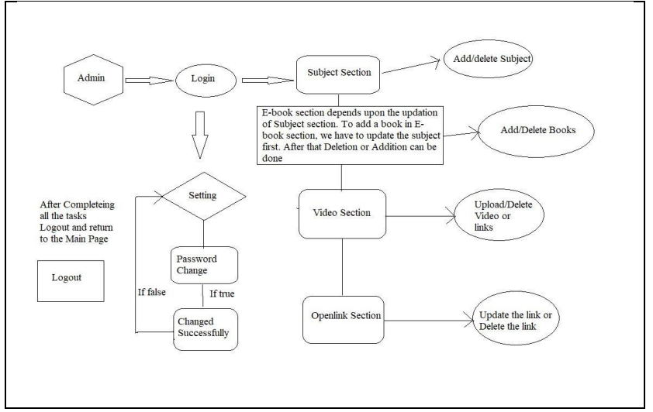
Architecture

Slide 12
Modules
Admin
The entire system is monitored by the Admin.
Admin provides facility of student and staff registration and login.
Students Interface
-------------------------------------------------------------------------------------------------------------------------------------------------------------------------------------------------------------------------------------------------------------------------------------------------------------------------------------------
Users are allowed to have access to all learning materials
Students can see the condition of availability and rate the books after the read
Staff - Library Staff, Mentors Interface
-----------------------------------------------------------------------------------------------------------------------------------------------------------------------------------------------------------------------------------------------------------------
Mentors can upload learning materials like videos , audios etc.

Slide 13
UML Diagrams CLASS DIAGRAM

Slide 14
USE CASE DIAGRAM

Slide 15
SEQUENCE DIAGRAM

Slide 16
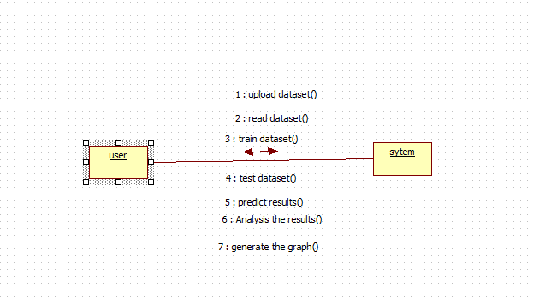
COLLABORATION DIAGRAM

Slide 17
ACTIVITY DIAGRAM

Slide 18
DEPLOYMENT DIAGRAM

Slide 19
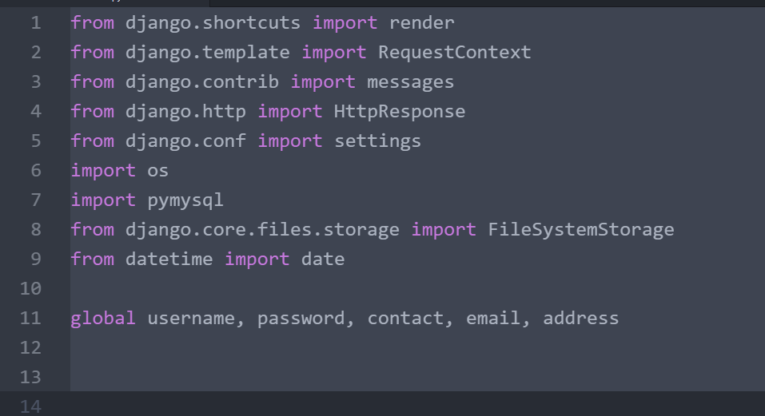
Sample Codes

Slide 20
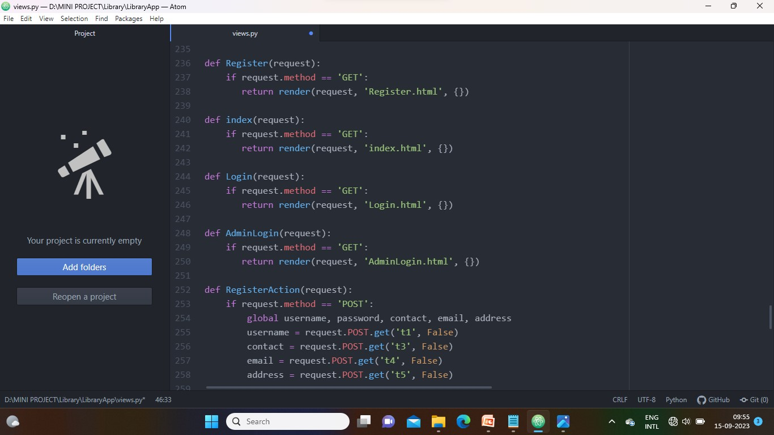

Slide 21
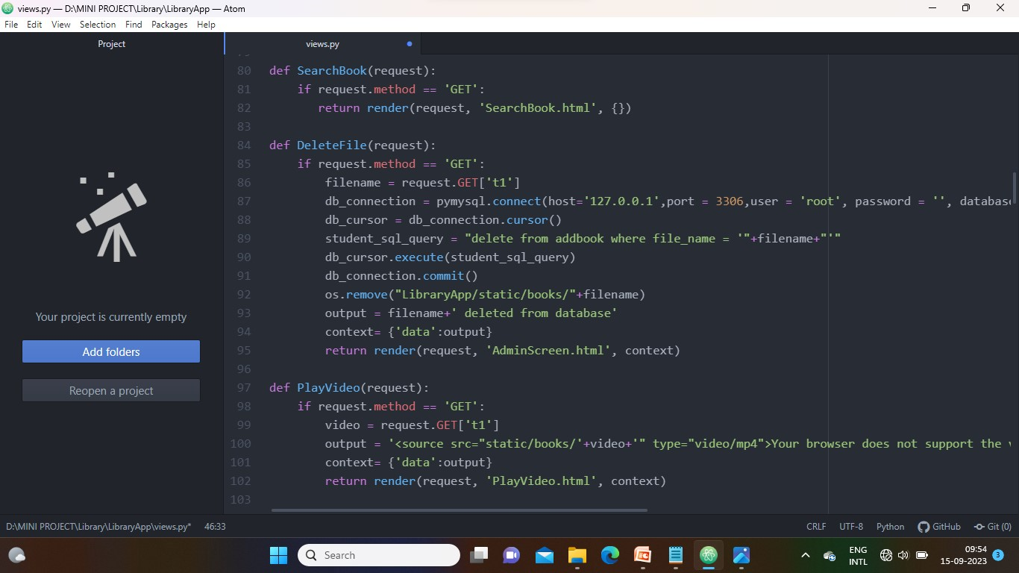

Slide 22
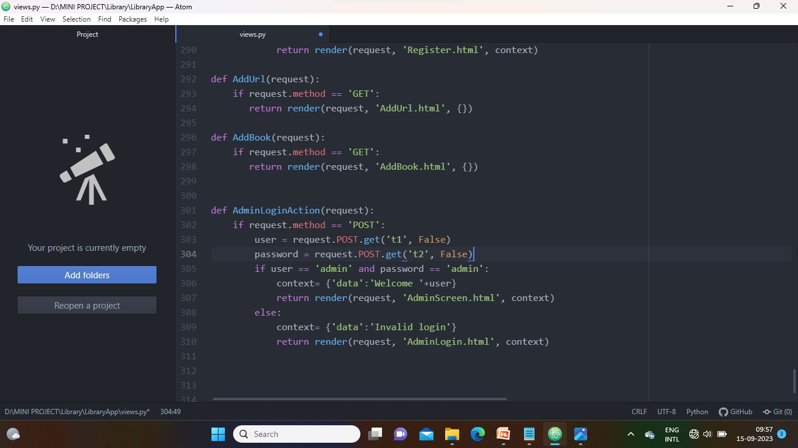

Slide 23
RESULTS
This website provides a computerized version of library management system which will benefit the students as well as the staff of the library.

Slide 24
Conclusion
It makes entire process online where student can search books, staff can generate reports and do book transactions.
It also has a facility for student login where student can login and can see status of books issued as well request for book or give some suggestions.
It has a facility of teacher’s login where teachers can add lectures notes and also give necessary suggestion to library and also add info about workshops or events happening in our college or nearby college in the online notice board.

Slide 25
Future Scope
There is a future scope of this facility that many more features such as online lectures video tutorials can be added by teachers as well as online assignments submission facility , a feature Of group chat where students can discuss various issues of engineering can be added to this project thus making it more interactive more user friendly and project which fullfills each users need in the best way possible.

Slide 26
References
http://www.w3schools.com/html/html_intro.asp
http://www.Udemy.com/css/css_background.asp
http://www.w3schools.com/js/js_datatypes.asp

Slide 27
GITHUB LINK
https://github.com/Anu-Lingampalli/E-LIBRARY

Slide 28

.
.

